Slide 1

Learning to Learn from Corrupted Data for Few-Shot Learning [IJCAI’23]
Flavio
Problem definition and approach overview
Few-shot learning (Few Shot Learning - EXPLAINED! - YouTube, badly introduced in the paper)
Only a limited number of training samples
Use of two (siamese) models to learn (to learn!, not to classify).
Feed them with different inputs to teach them to recognize whether they belong to the same class or not
Real-life is noisy
Random noise (data transmission, gaussian noise, …)
Incorrect labeling
Target challenge
Few-shot learning in real-life noisy environment
SoA limitations
Previous works on few-shot learning consider ‘clean’ data
Proposed Solution
Peer Collaboration Learning (PCL) framework
One peer model evaluates input sample importance based on processed information received from the other model, and vice versa.

Slide 2
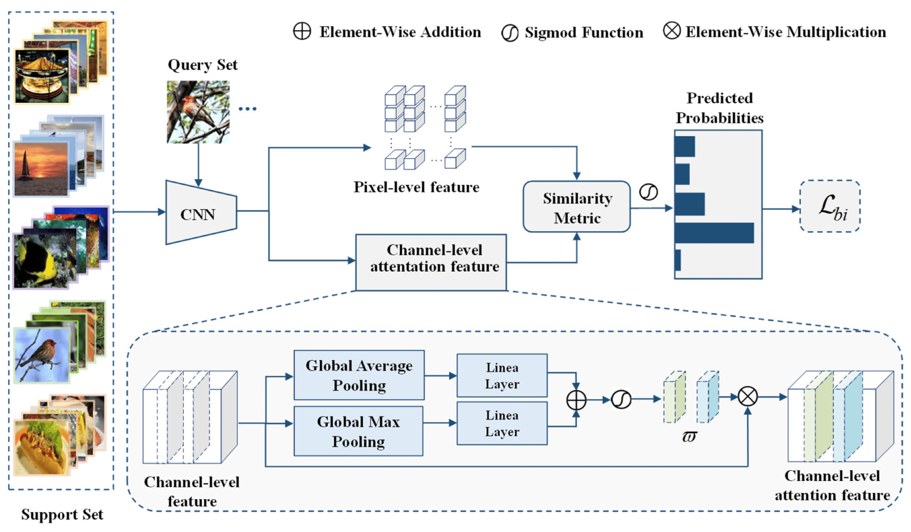
Learning to Learn from Corrupted Data for Few-Shot Learning [IJCAI’23]
Flavio
State-of-the-art
Few-shot learning has been proposed in multiple works
Considering clean data and correct labels
Few-Shot Learning Based on Double Pooling Squeeze and Excitation Attention [MDPI’22]

Slide 3
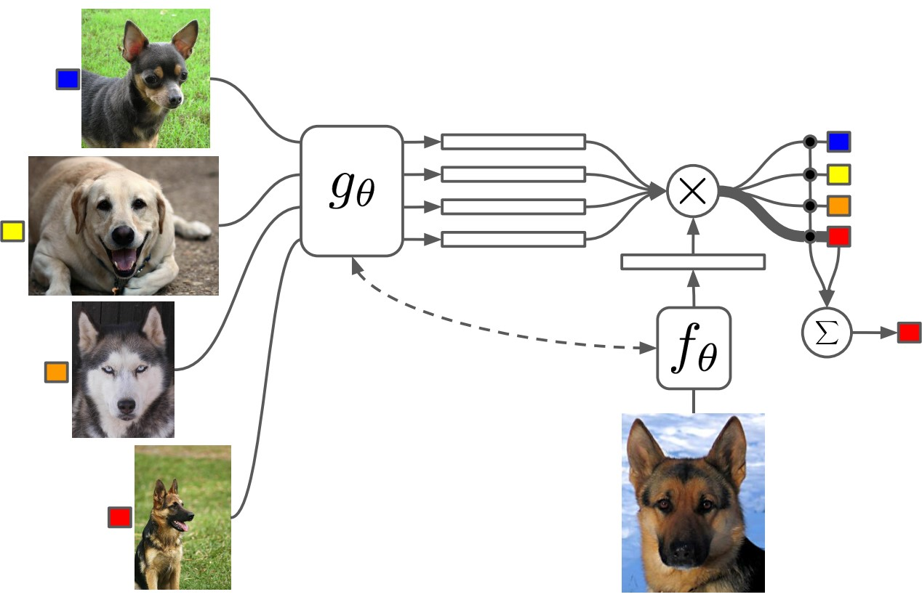
Learning to Learn from Corrupted Data for Few-Shot Learning [IJCAI’23]
Flavio
State-of-the-art
Few-shot learning has been proposed in multiple works
Considering clean data and correct labels
Matching Networks for One Shot Learning [NIPS’16]

Slide 4
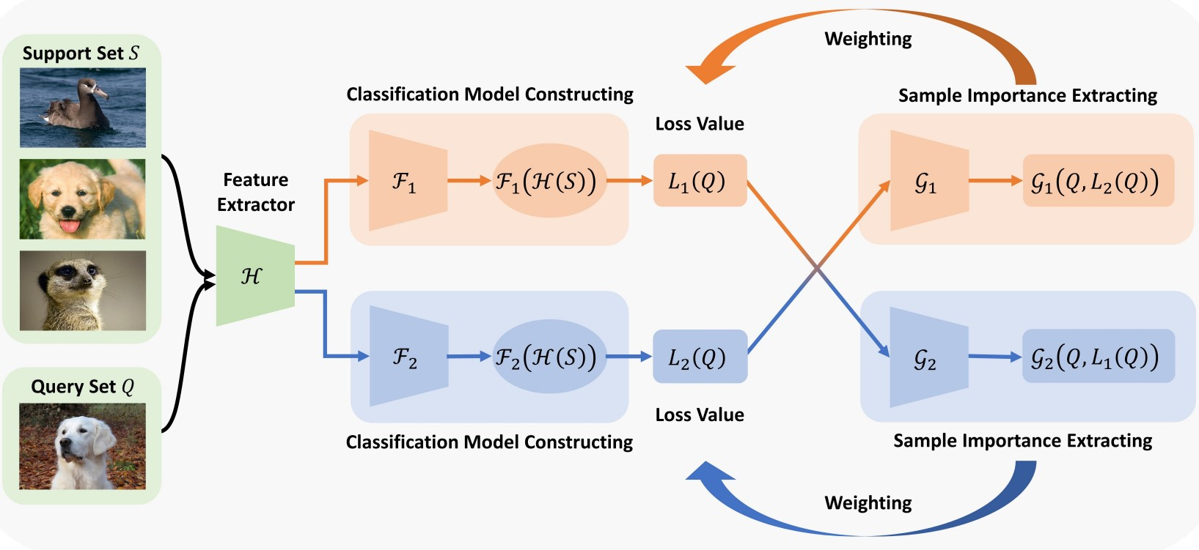
Learning to Learn from Corrupted Data for Few-Shot Learning [IJCAI’23]
Flavio
Proposed solution
Same as SoA up to here

Slide 5
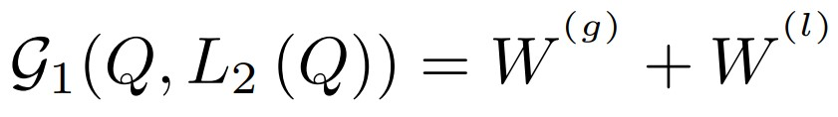
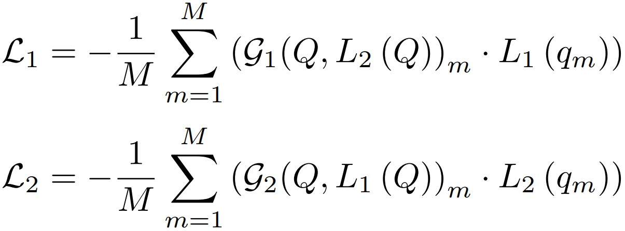
Learning to Learn from Corrupted Data for Few-Shot Learning [IJCAI’23]
Flavio
Some maths…
W^{(g)} and W^{(l)} are global and local weight estimations based on biLSTM models
WHY THIS SHOULD WORK?
1. PCL framework alleviates the impact of the noise that may exist in base training data on few-shot models
2. PCL leverages two modules to collaboratively learn from different perspectives to increase the capability to discriminate the noise
3. Each module adopts the importance information of different samples to guide its own update. In this way, few-shot models can automatically identify the importance of different samples and filter the noise Clear?

Slide 6
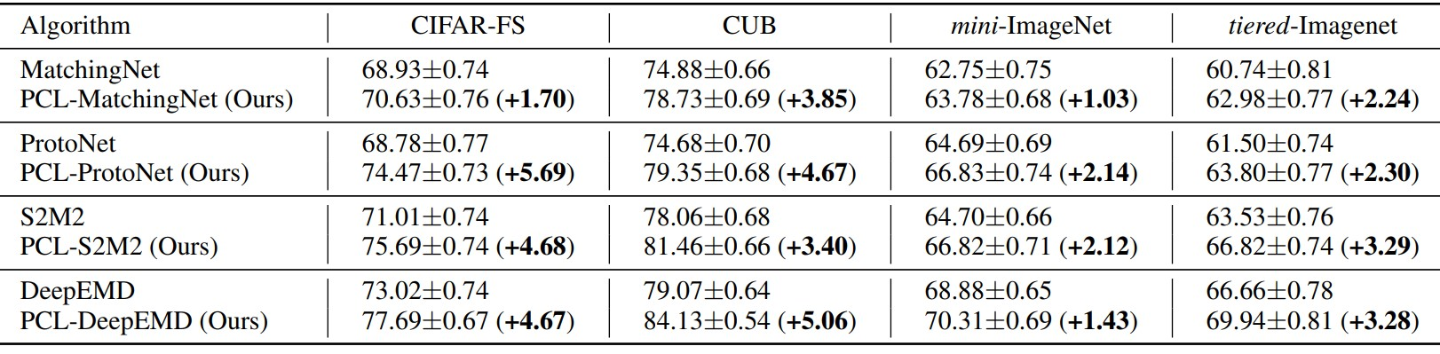
Learning to Learn from Corrupted Data for Few-Shot Learning [IJCAI’23]
Flavio
Experiments
Set-up and baselines
MatchingNet, ProtoNet, S2M2, and DeepEMD baselines
CIFAR-FS, CUB, mini-ImageNet, and tiered-Imagenet datasets
NVIDIA Tesla V100 and Intel Xeon Gold 6240
PCL github repo
5-way 5-shot evaluation setting in the table below

Slide 7
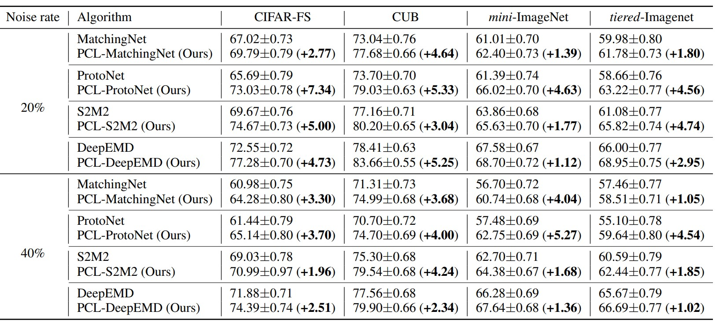
Learning to Learn from Corrupted Data for Few-Shot Learning [IJCAI’23]
Flavio
Experiments
Including incorrect labels

Slide 8
Learning to Learn from Corrupted Data for Few-Shot Learning [IJCAI’23]
Flavio
Conclusions
Overall, not an impressive paper
Badly written (typos, repeated sentences in the same paragraph, unclear sentences)
Hard to read, don’t clearly motivates what they do and why it works
Robustness claims are false. Accuracy may be improved, but accuracy is not.
Noise is introduced only to claim a new novelty with respect to SoA
Apparently, exchanging losses in peer networks improves accuracy in few-shot learning

